Slide 1
Part I

Slide 2
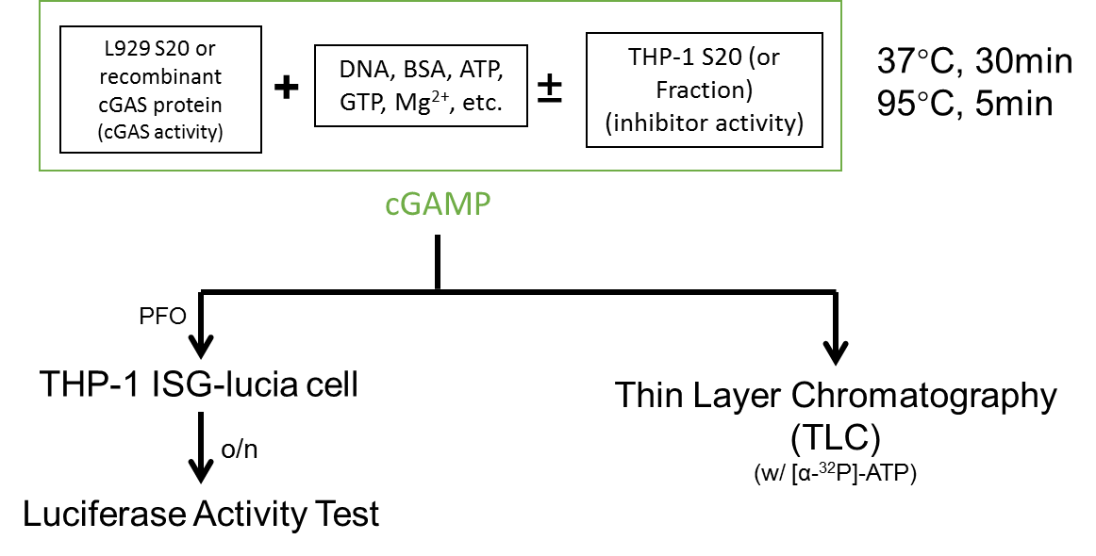
Figure 3-1
50ug L929 s20
3ng cGAS

Slide 3
Figure 3-2
Purification Method | Activity | Yield | Purification Fold
40% AmSO₄ cut | About half in sup, half in pellet | ~50% | 3-4x
Mono S | FT |  | ~1x
HiTrap Q HP | Bind | ~100% | ~5x
Mono Q | ~70%B | 30% | 15x
Superose 6 | Void Volumn | 80% | 4x
Phenyl | FT | ~60% | 1.5x
Blue | FT and 25%B | 30% | ~4x
CHT | 50%B and 100%B | 15-20% | 50x
Octyl | FT | 20% | 2x
cGAS affinity | FT | 70% | ?
ANX FF | 100%B | 90% | 4x
Q FF | 100%B | ~100% | 2x
Heparin HP | FT | <30% | ?
Glycerol Gradient (10%~50%) | Bottom | 70% | 3x

Slide 4
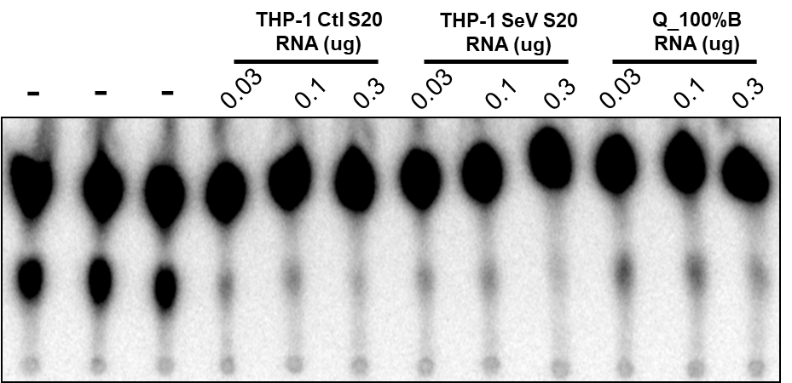
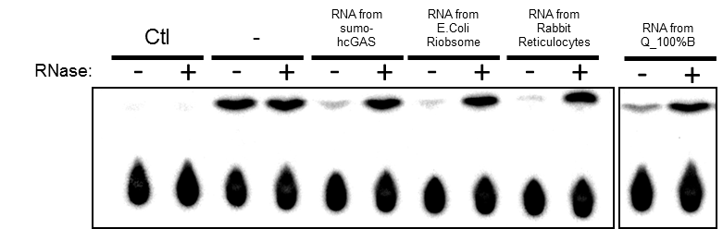
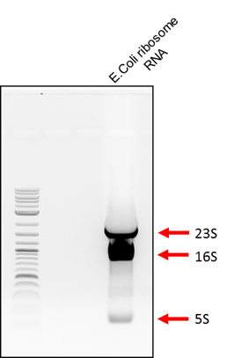
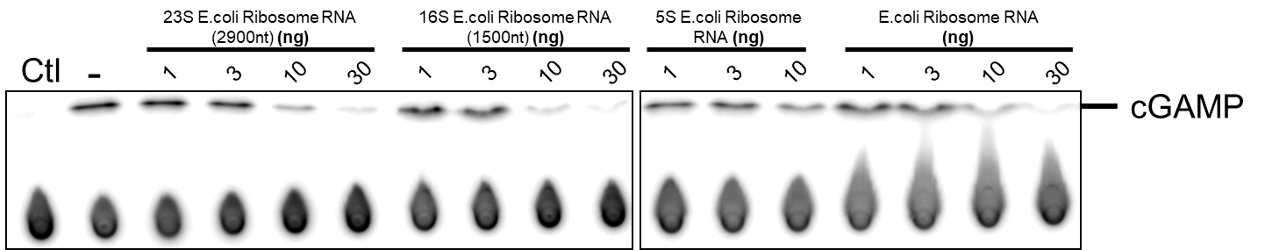
Figure 3-3

Slide 5
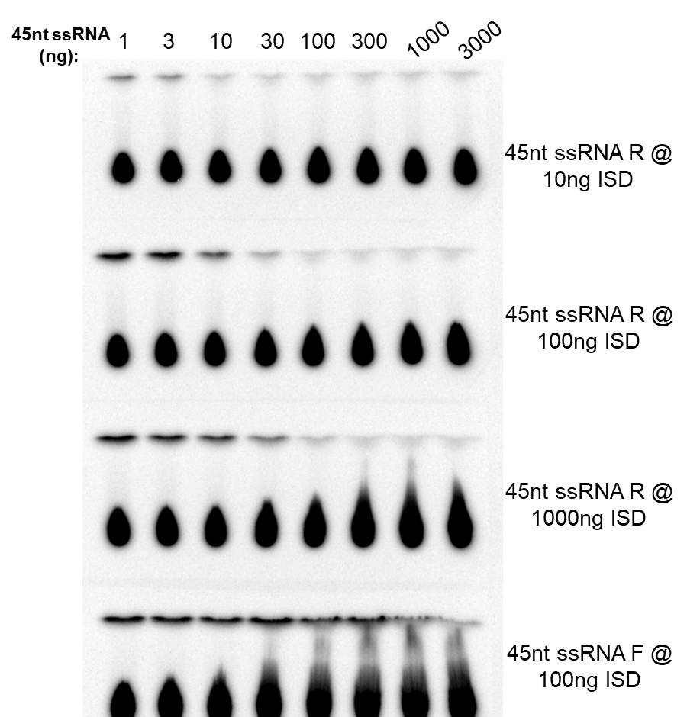
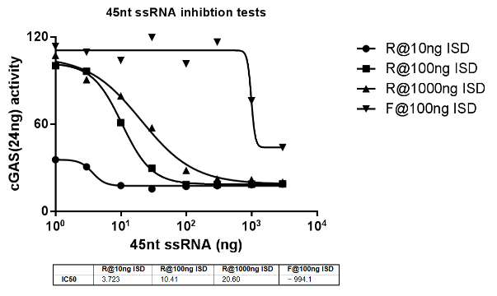
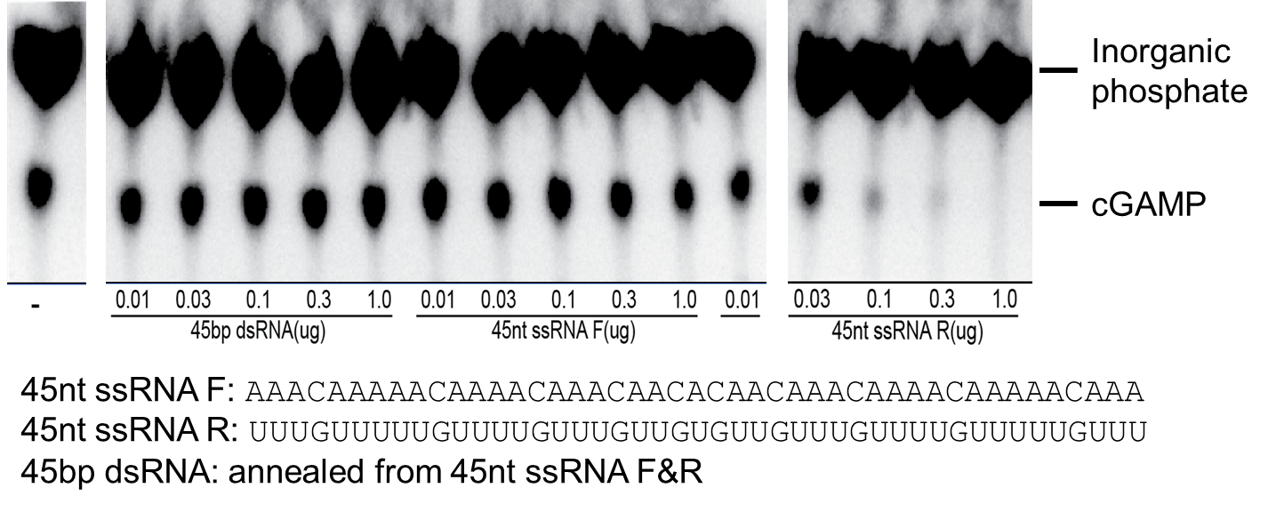
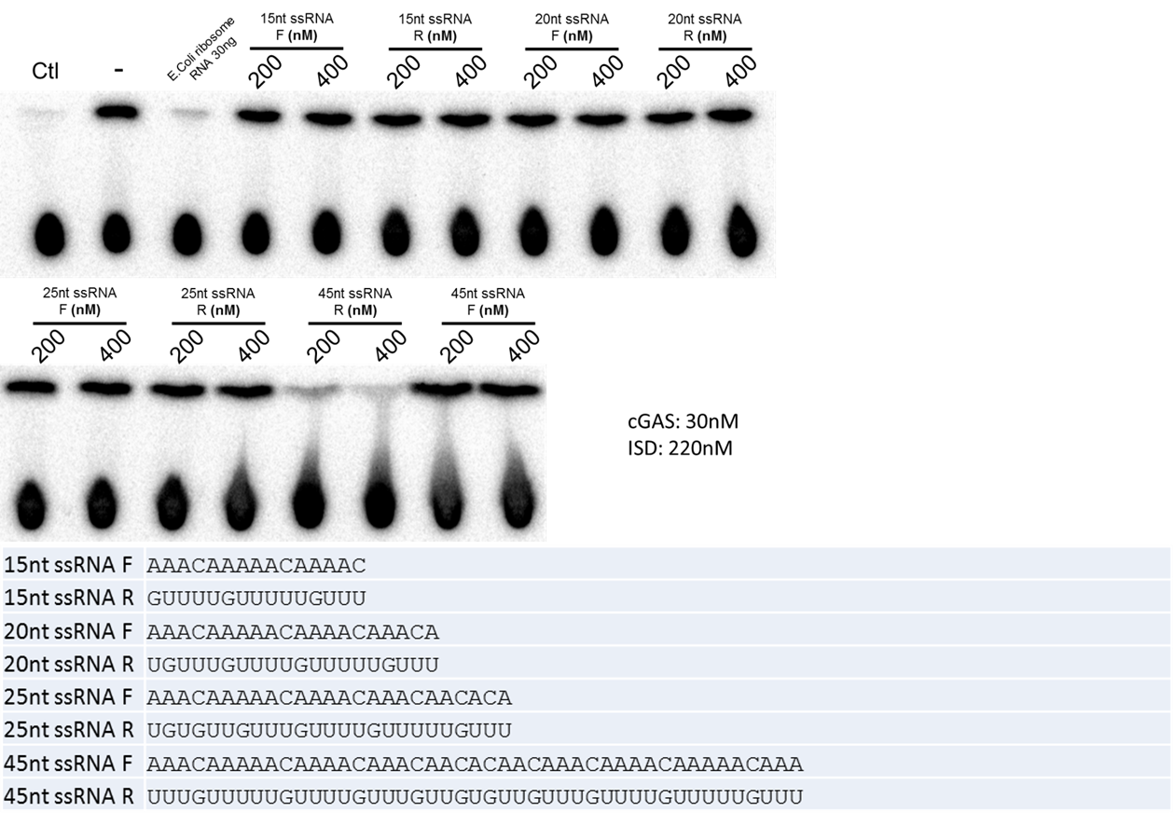
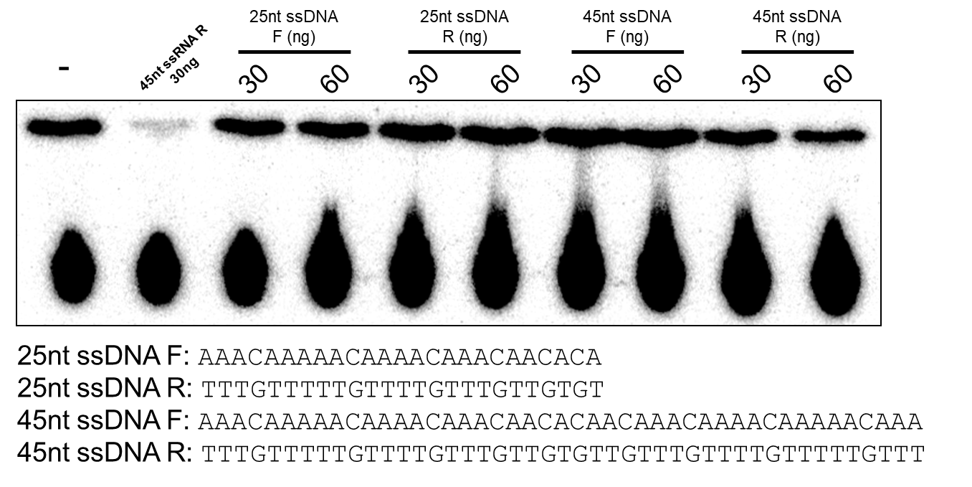
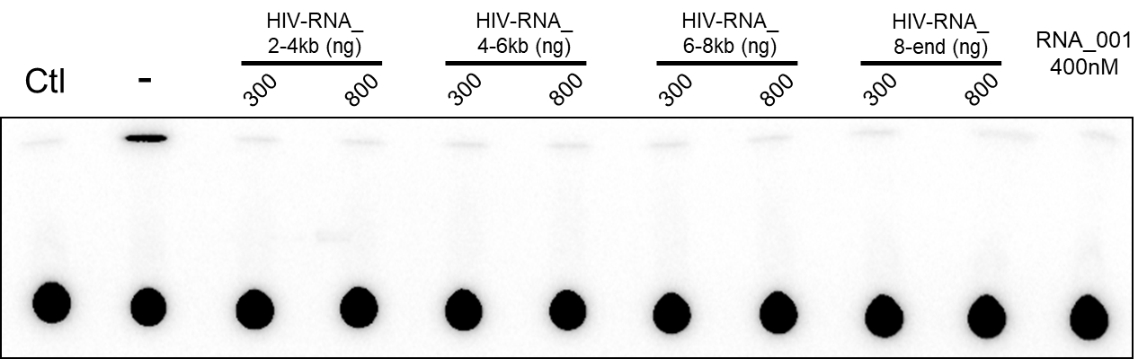
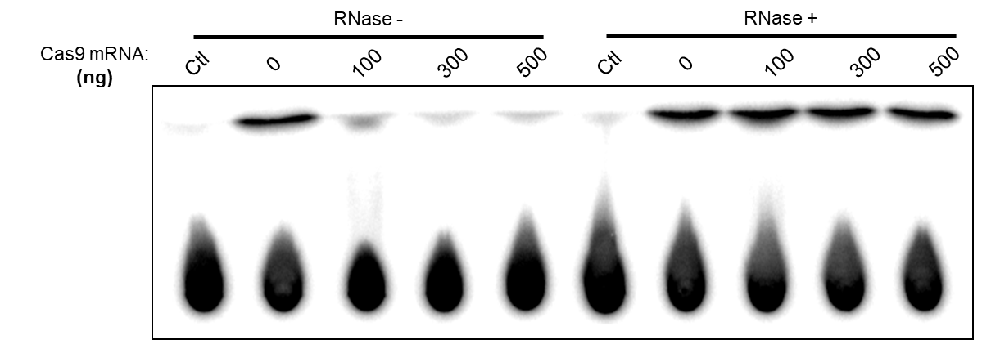
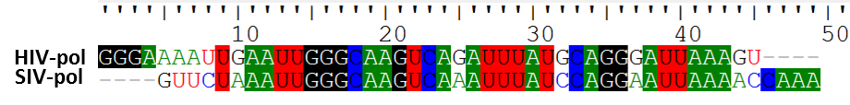
Figure 3-4

Slide 6
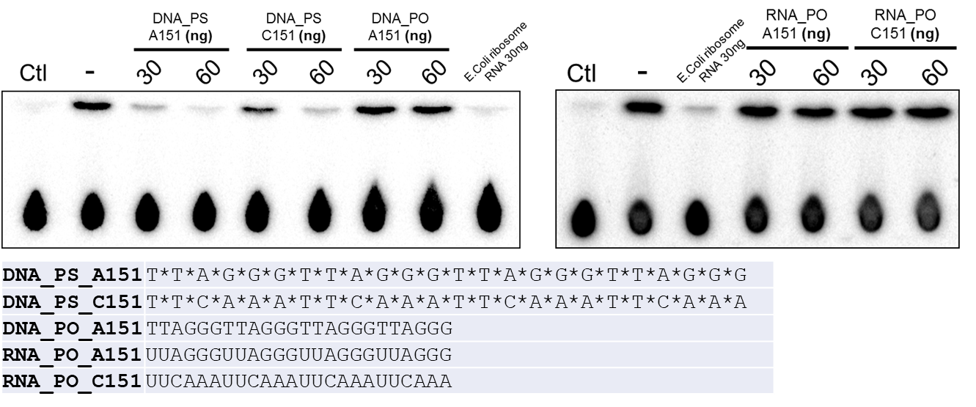
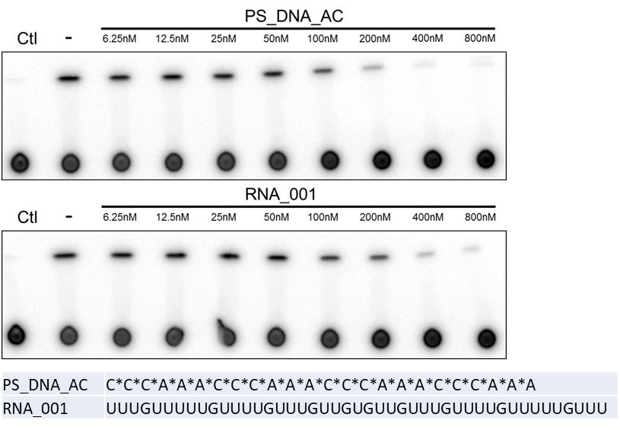
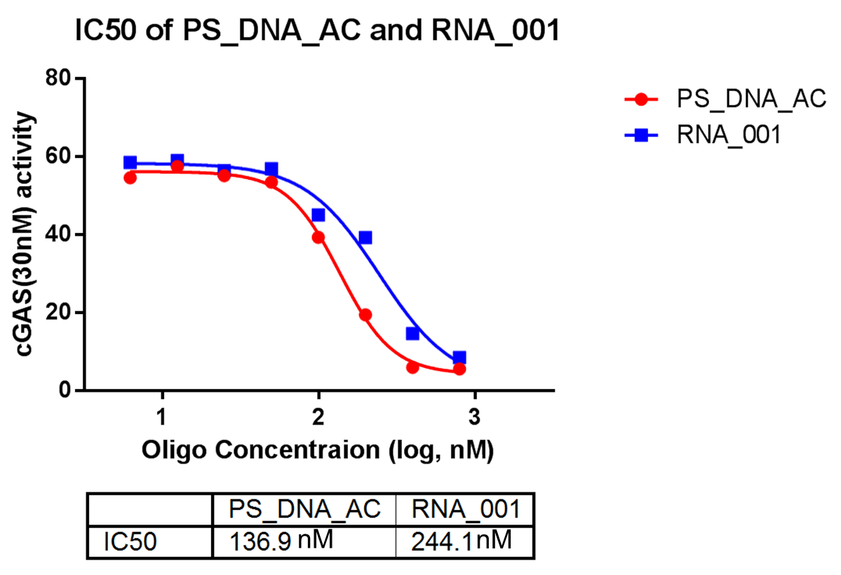
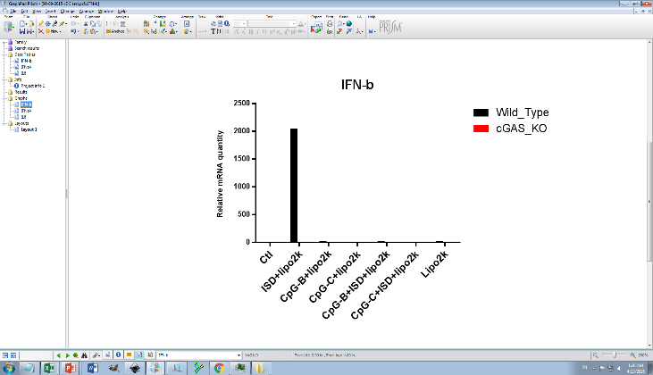
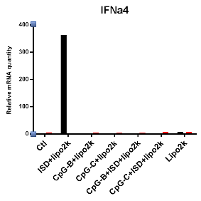
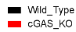
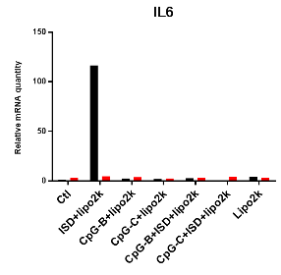

Figure 3-5

Slide 7
Part II

Slide 8
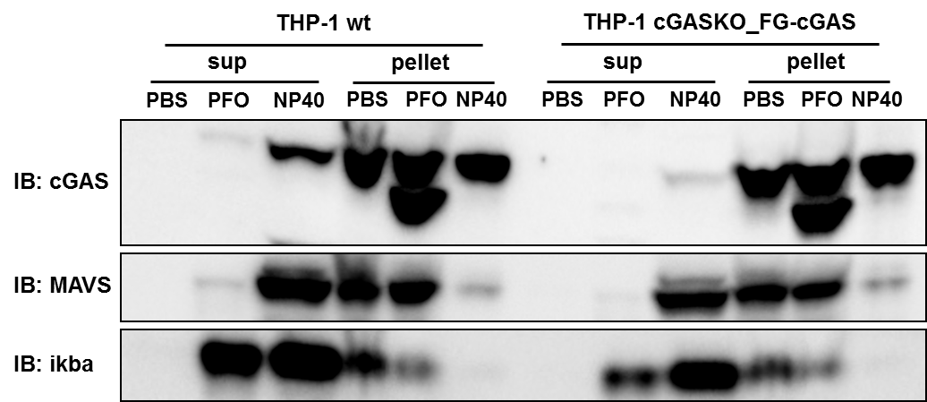
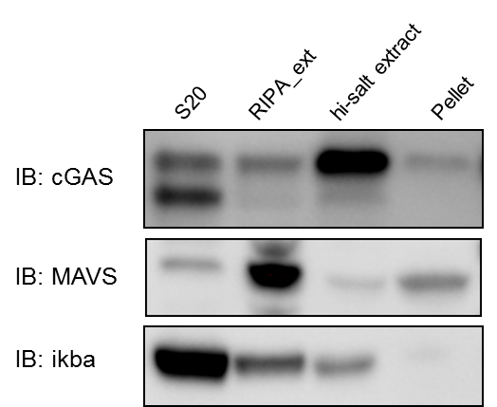

Slide 11
End

Slide 12
Figure 3-1

